Slide 1
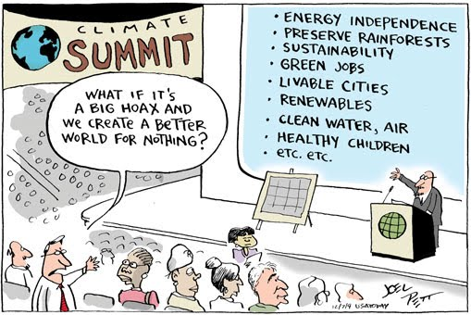
Global warming as an opportunity
Cheryl Beth Silverman Memorial Lecture
The Academy of Natural Sciences, Drexel University, May 8, 2019
Raymond Najjar
Notes:
Cartoon by Joel Pett, 2009

Slide 2
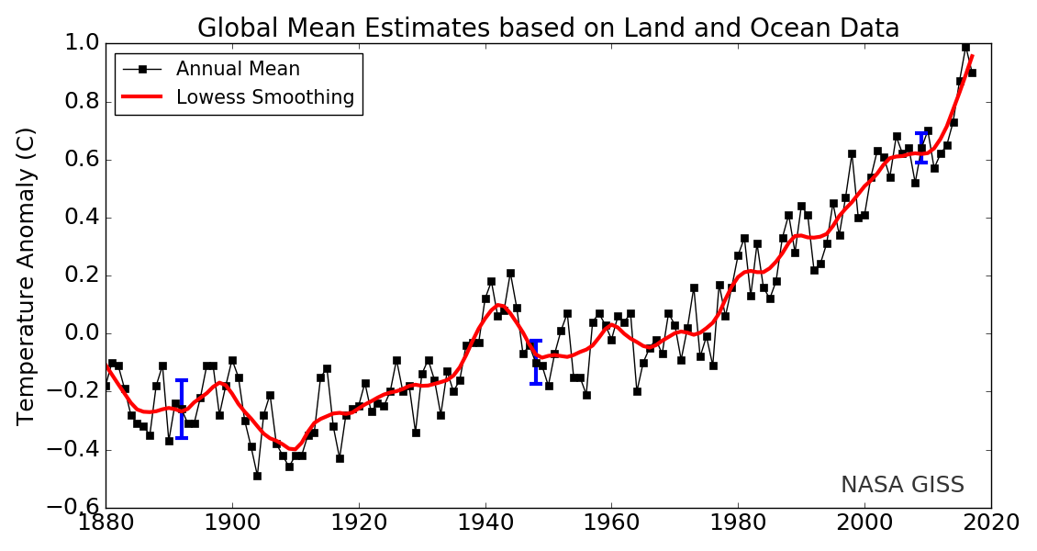
Earth is rapidly warming
1951–1980 average
95% confidence range
Source: NASA
Notes:
Source is https://data.giss.nasa.gov/gistemp/graphs/

Slide 3
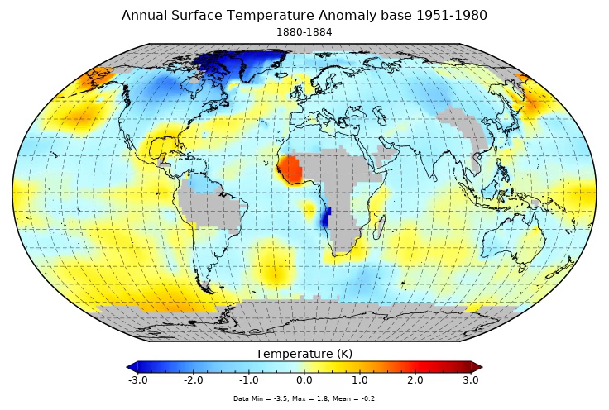
But the warming is not uniform
Source: NASA
Notes:
https://data.giss.nasa.gov/gistemp/animations/

Slide 4


The greenhouse effect in three steps
1. Solar radiation warms Earth
2. Earth’s radiation absorbed in atmosphere
3. Atmosphere’s radiation further warms Earth—by 60 ºF

Slide 5
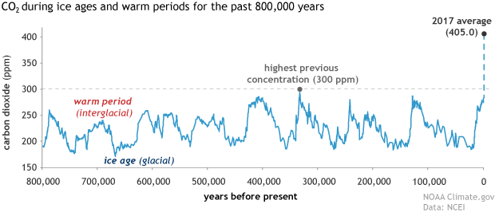
CO₂ levels now are higher than they have been for at least 800,000 years
Notes:
https://www.climate.gov/news-features/understanding-climate/climate-change-atmospheric-carbon-dioxide

Slide 6
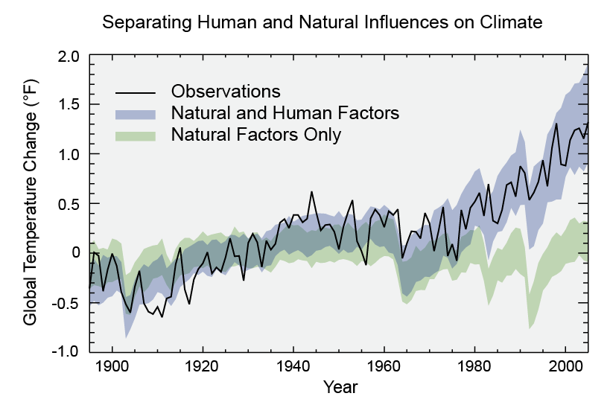
Humans are the cause of global warming
Shading = 5th to 95th percentile of models
Walsh et al. (2014)
Notes:
Walsh, J., Wuebbles, D., Hayhoe, K., Kossin, J., Kunkel, K., Stephens, G., Thorne, P., Vose, R., Wehner, M., Willis, J., Anderson, D., Doney, S., Feely, R., Hennon, P., Kharin, V., Knutson, T., Landerer, F., Lenton, T., Kennedy, J., Somerville, R., 2014. Chapter 2: Our Changing Climate. In: J.M. Melillo, T.C. Richmond, G.W. Yohe (Editors), Climate Change Impacts in the United States: The Third National Climate Assessment. U.S. Global Change Research Program, pp. 19-67.

Slide 7
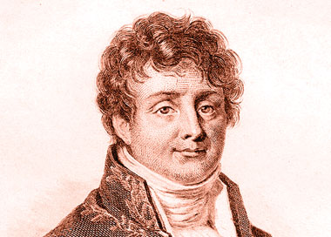
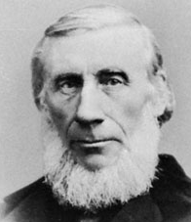
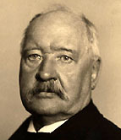
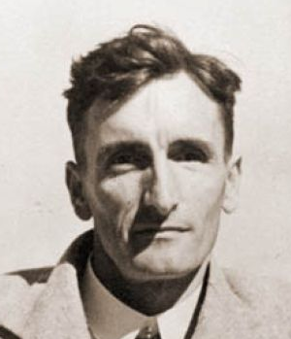
The greenhouse effect is well established
1824: Joseph Fourier describes natural greenhouse effect
1858–1861: Eunice Foote and John Tyndall identify greenhouse gases
1896: Svante Arrenhius estimates greenhouse effect of fossil fuel CO₂
1938: Guy Callendar documents warming and CO₂ increase

Slide 8
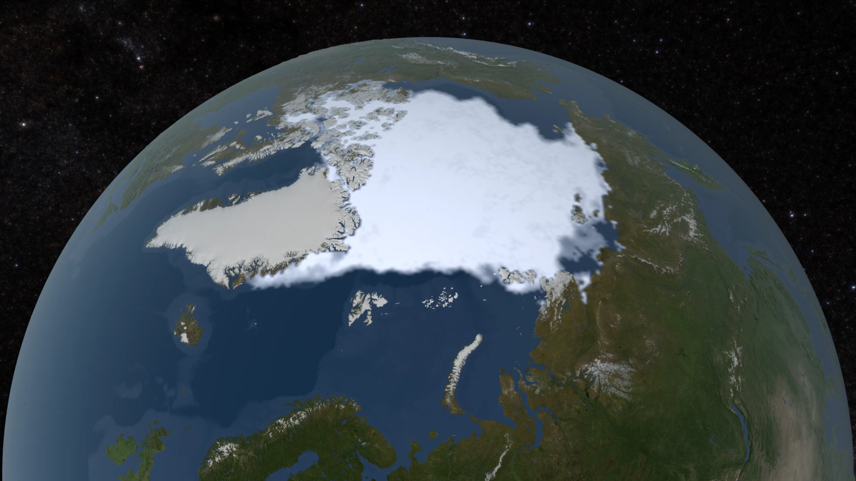
Arctic sea ice is rapidly melting
Source: NASA
Notes:
https://svs.gsfc.nasa.gov/4686

Slide 9
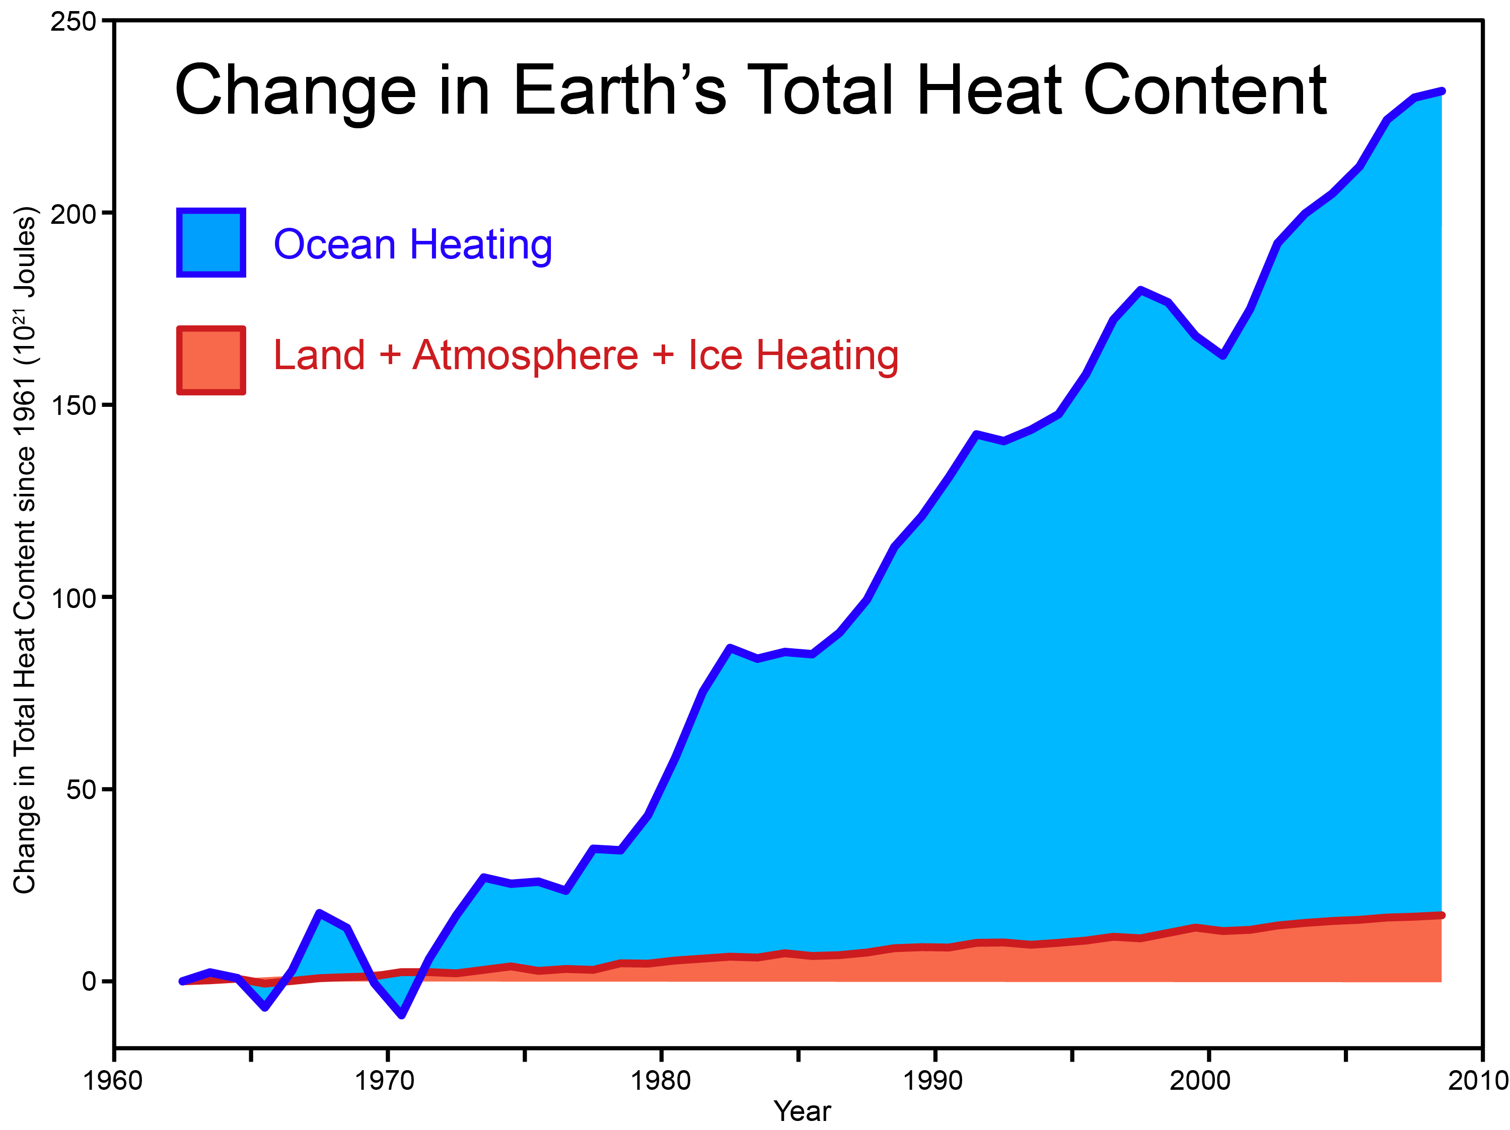
Most of the heat from global warming is going into the ocean
200
Change in total heat content since 1961 (10²¹ Joules)
100
0
1960 1970 1980 1990 2000 2010
skepticalscience.com after Church et al. (2011)
Notes:
Church, J.A., White, N.J., Konikow, L.F., Domingues, C.M., Cogley, J.G., Rignot, E., Gregory, J.M., van den Broeke, M.R., Monaghan, A.J., Velicogna, I., 2011. Revisiting the Earth's sea-level and energy budgets from 1961 to 2008. Geophysical Research Letters 38, L18601.

Slide 10
Sea level is accelerating
Notes:
http://www.columbia.edu/~mhs119/SeaLevel/

Slide 11
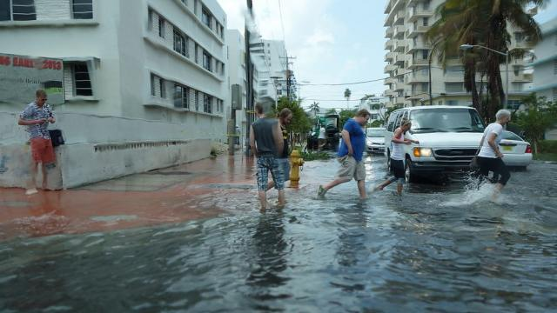
“Sunny day” flooding in Miami
Photo source: Grist

Slide 12
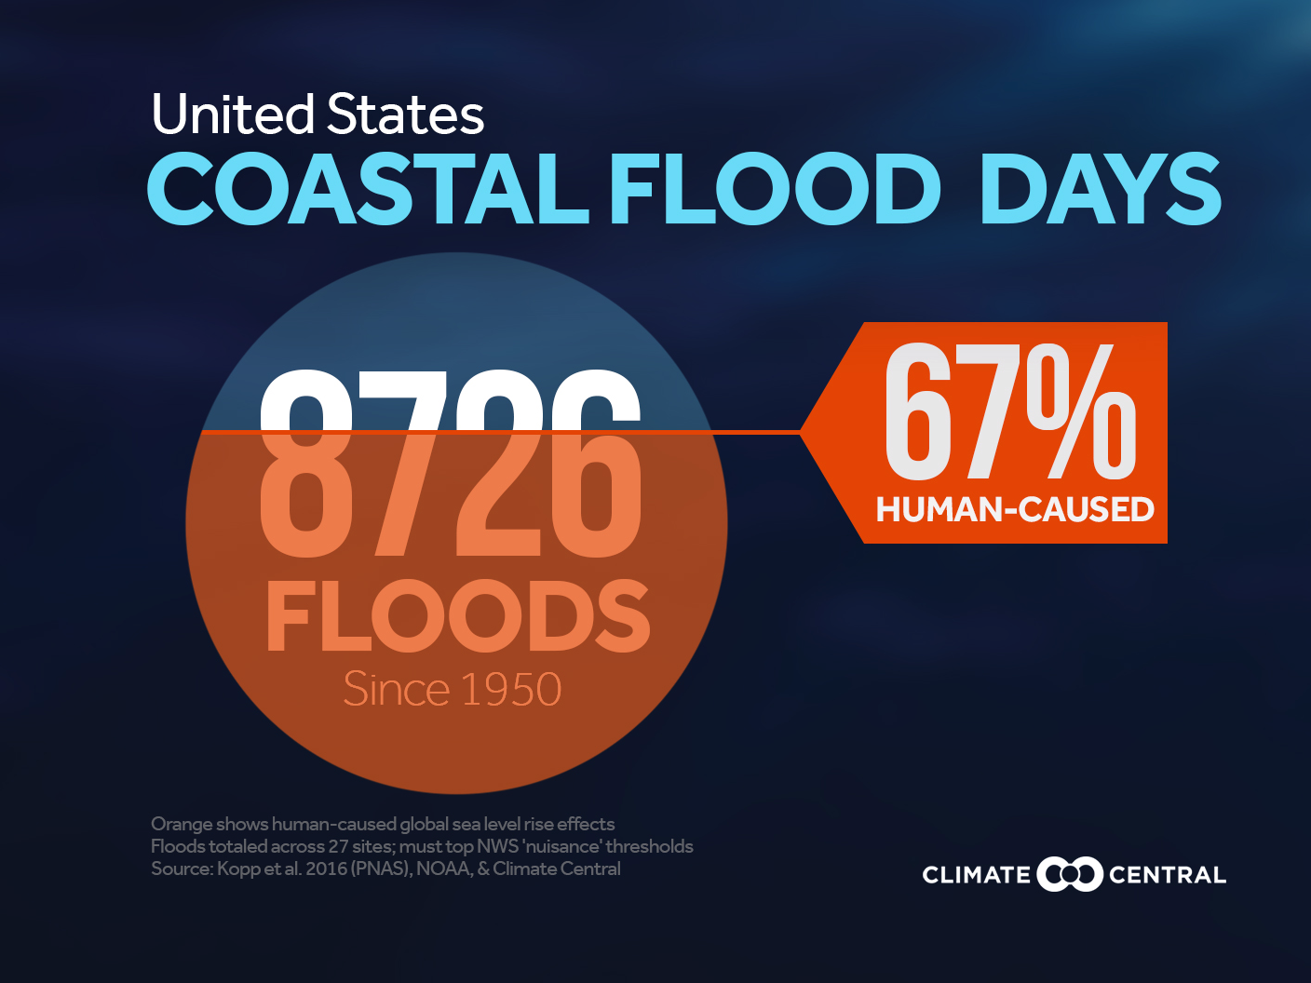

Slide 13
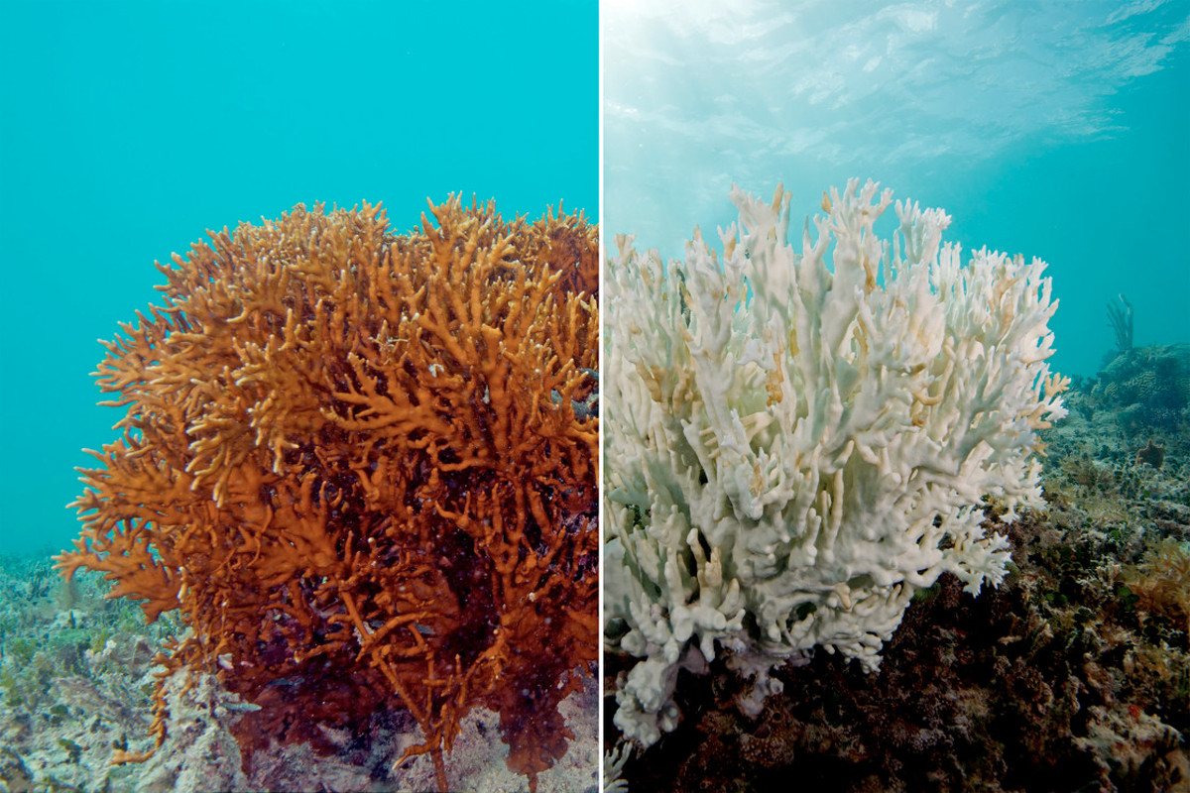
Corals bleach—lose their symbiotic algae—when they are stressed
Fire coral before 2016 warming event
After
Notes:
Photo of a fire coral that experienced severe bleaching in the 2016 mass bleaching event. The Ocean Agency / XL Catlin Seaview Survey / Richard Vevers. https://www.vox.com/science-and-health/2017/4/18/15272634/catastrophic-coral-bleaching-great-barrier-reef-map

Slide 14
Warming causes bleaching
Percent of reef bleached
Each data point represents an individual reef on the Great Barrier Reef in May/April 2016
Hughes et al. (2017)
Degree heating weeks (ºC – weeks)
Notes:
Hughes, T.P., Kerry, J.T., Álvarez-Noriega, M., Álvarez-Romero, J.G., Anderson, K.D., Baird, A.H., Babcock, R.C., Beger, M., Bellwood, D.R., Berkelmans, R., Bridge, T.C., Butler, I.R., Byrne, M., Cantin, N.E., Comeau, S., Connolly, S.R., Cumming, G.S., Dalton, S.J., Diaz-Pulido, G., Eakin, C.M., Figueira, W.F., Gilmour, J.P., Harrison, H.B., Heron, S.F., Hoey, A.S., Hobbs, J.-P.A., Hoogenboom, M.O., Kennedy, E.V., Kuo, C.-y., Lough, J.M., Lowe, R.J., Liu, G., McCulloch, M.T., Malcolm, H.A., McWilliam, M.J., Pandolfi, J.M., Pears, R.J., Pratchett, M.S., Schoepf, V., Simpson, T., Skirving, W.J., Sommer, B., Torda, G., Wachenfeld, D.R., Willis, B.L., Wilson, S.K., 2017. Global warming and recurrent mass bleaching of corals. Nature 543, 373–377.
Degree heating weeks are a bit complicated. First you compute the mean annual cycle in SST at monthly resolution. Second, of these 12 months, you find the month with the highest mean SST and you call it the maximum monthly mean (MMM) SST. The bleaching threshold is 1 deg C above the MMM. Third, you look at the past 12 weeks and find all of the half-week periods in which the 50-km SST is above the threshold. Call the exceedance DT. For each half week period, you multiply DT by 0.5 weeks. Then you add up all of these products to get DHW. Source: https://coralreefwatch.noaa.gov/satellite/education/tutorial/crw24_dhw_product.php

Slide 15
Massive coral bleaching occurred during 2014–2017
DHW = Degree Heating Weeks (ºC - weeks)
0 < DHW < 4
Coral bleaching likely
(4 < DHW < 8)
Coral mortality likely
(8 < DHW )
Eakin et al. (2018)
Notes:
Eakin, C.M., Liu, G., Gomez, A.M., De La Cour, J.L., Heron, S.F., Skirving, W.J., Geiger, E.F., Marsh, B.L., Tirak, K.V., Strong, A.E., 2018. Sidebar 3.1: Unprecedented Three Years of Global Coral Bleaching 2014–17. Bulletin of the American Meteorological Society 9, S74–75.

Slide 16
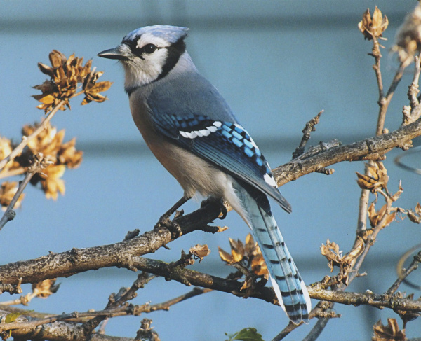
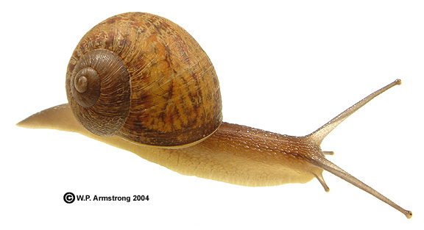
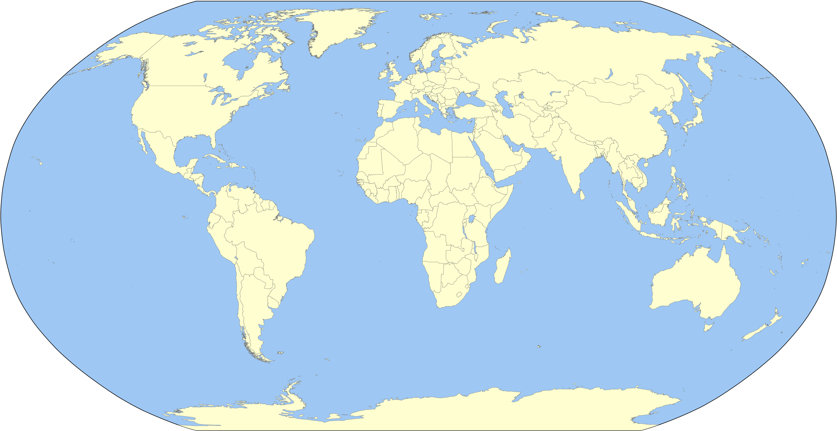

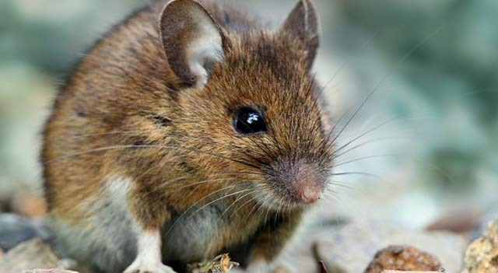
Animals are moving poleward
Birds
Mollusks
11 miles per decade
11 miles per decade
Mammals
Arthropods
Chen et al. (2011)
Notes:
Images: www.encyclopedia.com, waynesword.palomar.edu, dispatch.com, liveanimalist.com, en.wikipedia.org
Chen, I.C., Hill, J.K., Ohlemüller, R., Roy, D.B., Thomas, C.D., 2011. Rapid range shifts of species associated with high levels of climate warming. Science 333, 1024-1026.

Slide 17
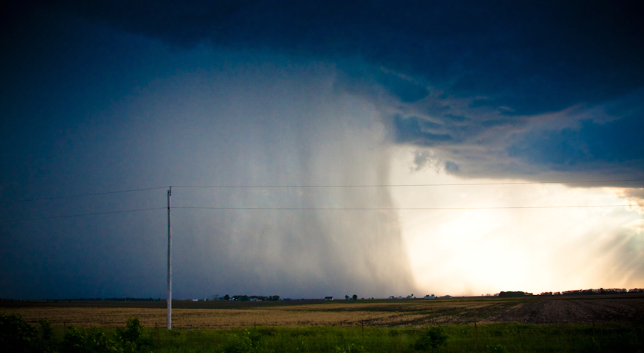
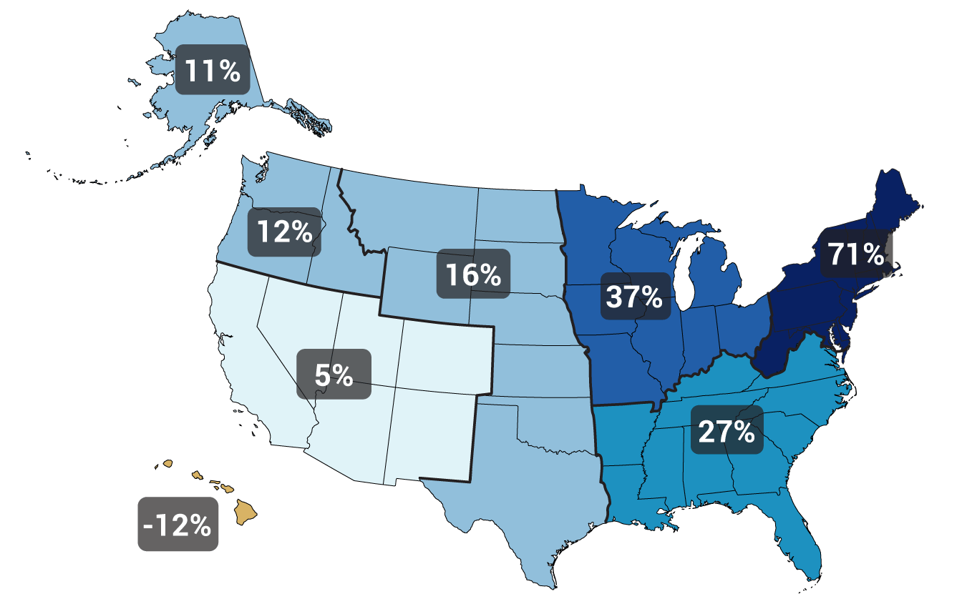
Heavy precipitation is increasing
Gustoflight.wordpress.com
Change in top 1% of rainiest days from 1958 to 2012
Walsh et al. (2014)
Notes:
Walsh, J., Wuebbles, D., Hayhoe, K., Kossin, J., Kunkel, K., Stephens, G., Thorne, P., Vose, R., Wehner, M., Willis, J., Anderson, D., Doney, S., Feely, R., Hennon, P., Kharin, V., Knutson, T., Landerer, F., Lenton, T., Kennedy, J., Somerville, R., 2014. Chapter 2: Our Changing Climate. In: J.M. Melillo, T.C. Richmond, G.W. Yohe (Editors), Climate Change Impacts in the United States: The Third National Climate Assessment. U.S. Global Change Research Program, pp. 19-67.

Slide 18
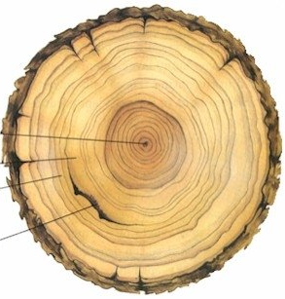
Tree rings tell the story of drought
First year
Rainy season
Dry season
Fire scar
Human influence on global droughts goes back 100 years
2012–2014 California drought worst in 1200 years
Marvel et al. (2019) and Griffin and K.J. Anchukaitis (2014)
Notes:
Image: https://www.esrl.noaa.gov/gmd/education/info_activities/pdfs/PSA_tree_rings.pdf
Marvel, K., Cook, B.I., Bonfils, C.J.W., Durack, P.J., Smerdon, J.E., Williams, A.P., 2019. Twentieth-century hydroclimate changes consistent with human influence. Nature 569, 59-65.
Griffin, D., Anchukaitis, K.J., 2014. How unusual is the 2012–2014 California drought? Geophysical Research Letters 41, 9017-9023.

Slide 19
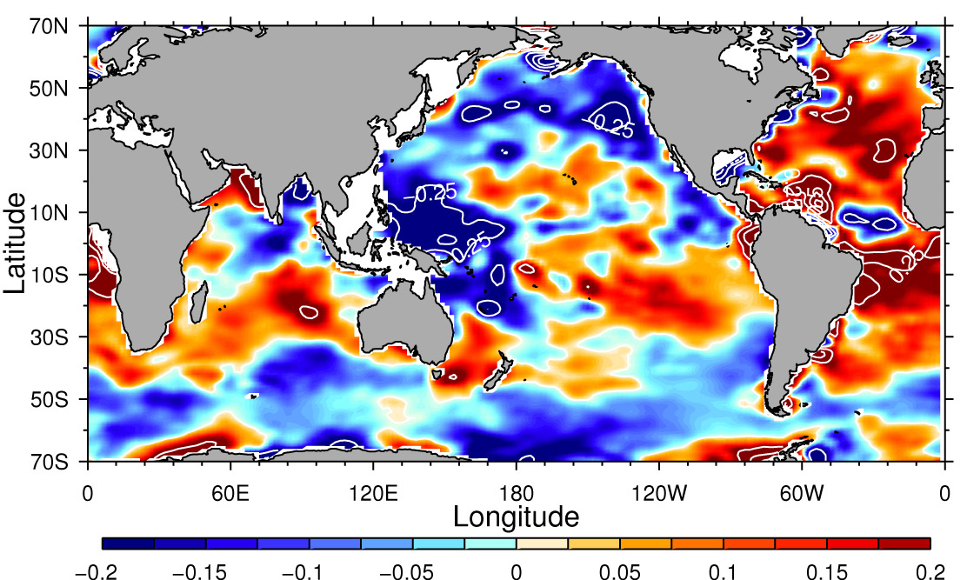
Increasing extremes: salty areas getting saltier, fresh areas are getting fresher
1950–2000 salinity change (g kg^{–1})
Durack et al. (2012)
Notes:
Durack, P.J., Wijffels, S.E., Matear, R.J., 2012. Ocean Salinities Reveal Strong Global Water Cycle Intensification During 1950 to 2000. Science 336, 455-458.

Slide 20
Record high ocean temperatures intensified Harvey and increased its flooding rains on land
“Harvey could not have produced so much rain without human-induced climate change”
Trenberth et al. (2018)
Notes:
Trenberth, K.E., Cheng, L., Jacobs, P., Zhang, Y., Fasullo, J., 2018. Hurricane Harvey Links to Ocean Heat Content and Climate Change Adaptation. Earth's Future 6, 730-744.

Slide 21
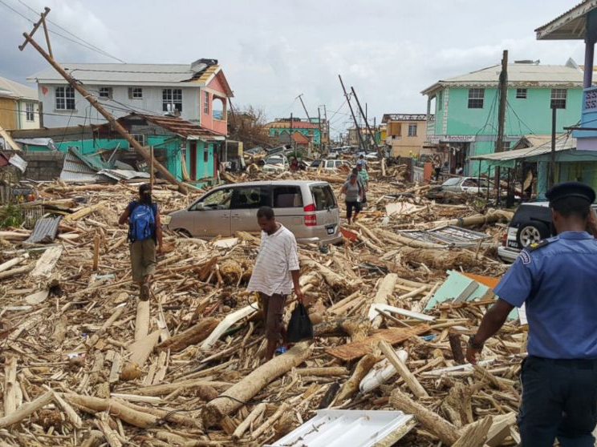
Maria's rain magnitude nearly five times more likely to occur today than in the 1950s
Keelings et al. (2019)
Notes:
Image: https://abcnews.go.com/International/hurricane-maria-strengthens-category-ravaging-puerto-rico/story?id=49997188
Keellings, D., & Hernández Ayala, J. J. (2019). Extreme rainfall associated with Hurricane Maria over Puerto Rico and its connections to climate variability and change. Geophysical Research Letters,46, 2964–2973. https://doi.org/10.1029/2019GL082077

Slide 22
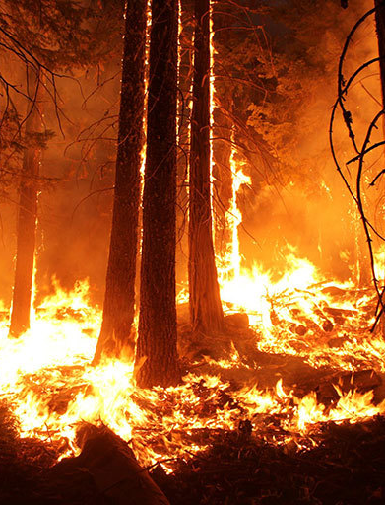
In the US West, climate change has doubled the area burned by forest fires
Actual area burned
25 million acres
20
15
10
5
0
Abatzoglou & Williams (2016)
Notes:
Abatzoglou, J.T., Williams, A.P., 2016. Impact of anthropogenic climate change on wildfire across western US forests. Proceedings of the National Academy of Sciences 113, 11770-11775.
Graphic: https://www.nytimes.com/interactive/2018/11/27/climate/wildfire-global-warming.html
Fire image credit: Credit: Mike McMillan/USFS. https://climate.nasa.gov/news/2315/study-fire-seasons-getting-longer-more-frequent/

Slide 23


Increasing wealth gap among countries due to climate change
Norway: 34% richer
Nigeria: 29% poorer
Diffenbaugh & Burke (2019)
Notes:
Diffenbaugh, N.S., Burke, M., 2019. Global warming has increased global economic inequality. Proceedings of the National Academy of Sciences, 201816020.
Images: https://www.nytimes.com/2019/04/22/climate/climate-change-global-wealth-gap.html?smid=nytcore-ios-share

Slide 24
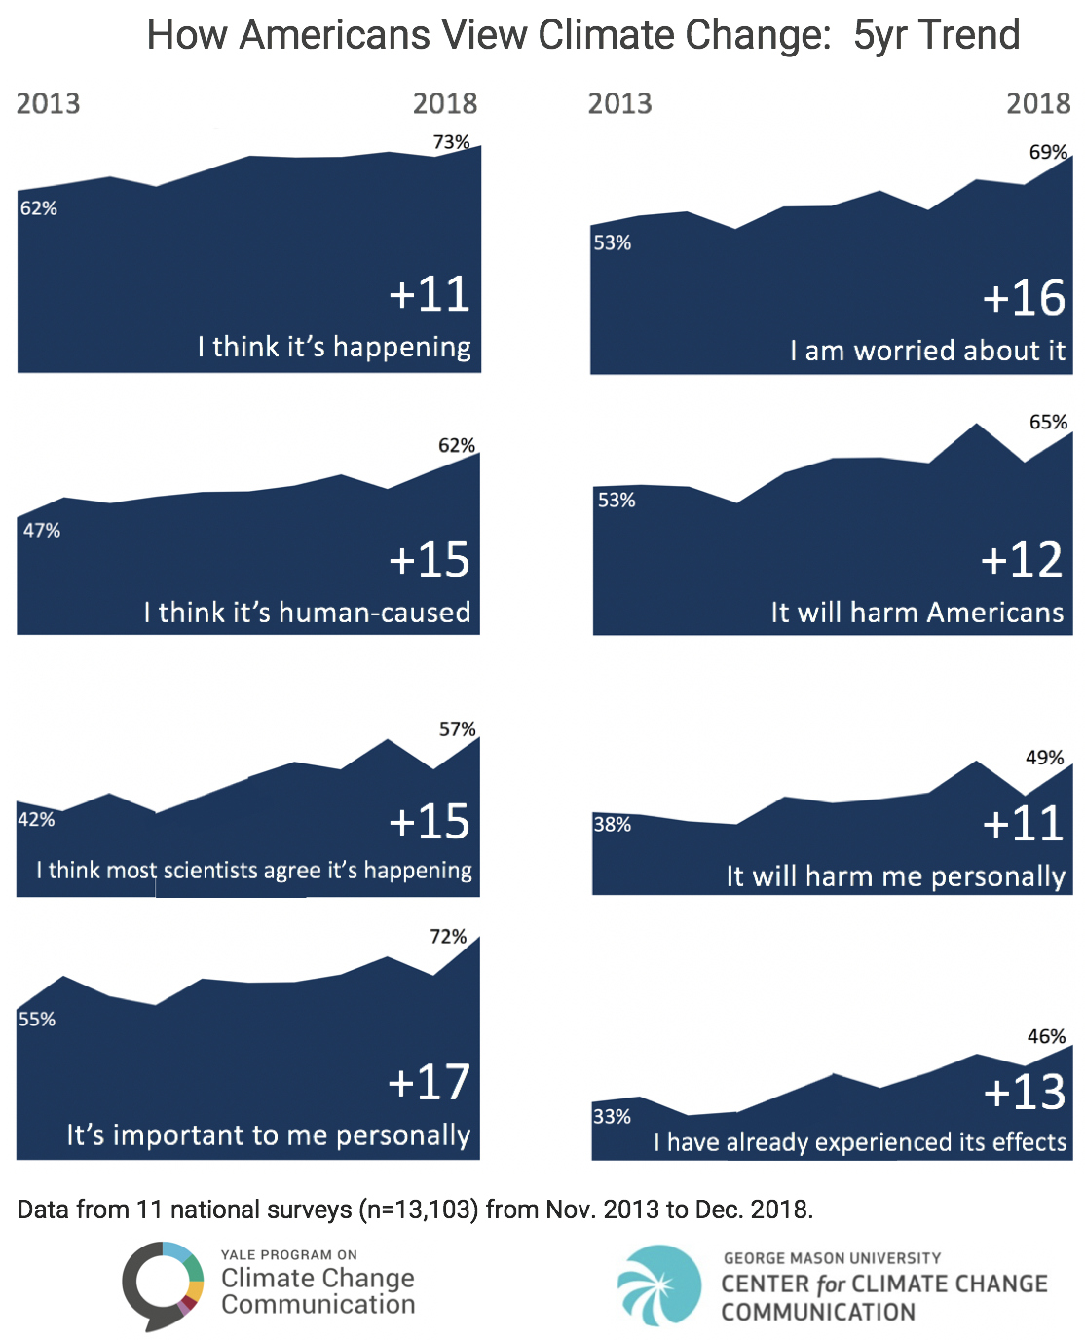
Notes:
https://climatecommunication.yale.edu/publications/a-growing-majority-of-americans-think-global-warming-is-happening-and-are-worried/

Slide 25
Notes:
https://climatecommunication.yale.edu/publications/a-growing-majority-of-americans-think-global-warming-is-happening-and-are-worried/

Slide 26
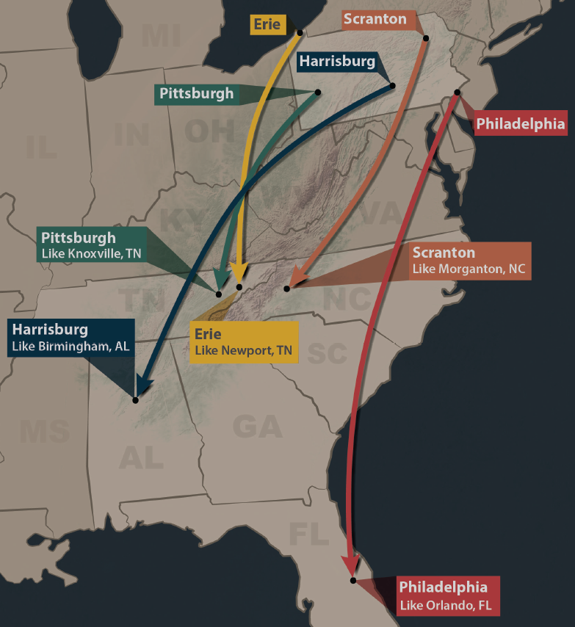
Summers in Pennsylvania will feel like those of the Southeast US by mid-century if heat trapping emissions trends continue
http://psiee.psu.edu/climate-impacts
Notes:
http://psiee.psu.edu/climate-impacts

Slide 27
Emissions really matter, especially in the long run
Union of Concerned Scientists (2008)
Notes:
Union of Concerned Scientists, 2008. Climate Change in Pennsylvania: Impacts and Solutions for the Keystone State. Cambridge, MA, 54 pp.

Slide 28
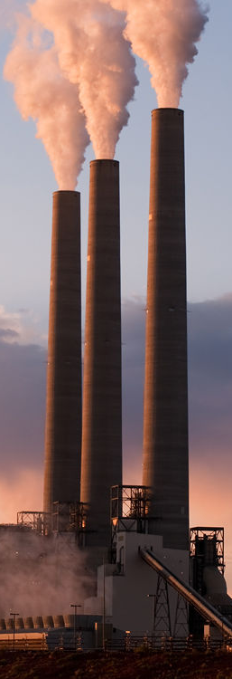
The US and EU have emitted about 50% of the CO₂ …
Others
Others
India
EU
India
… but make up only about 10% of the population
US
EU
US
China
China
Source: Global Carbon Project
Notes:
https://www.globalcarbonproject.org/carbonbudget/18/files/GCP_CarbonBudget_2018.pdf
Image: Robert Fullerton/Shutterstock

Slide 29
We have cleaned up our own messes before

Slide 30
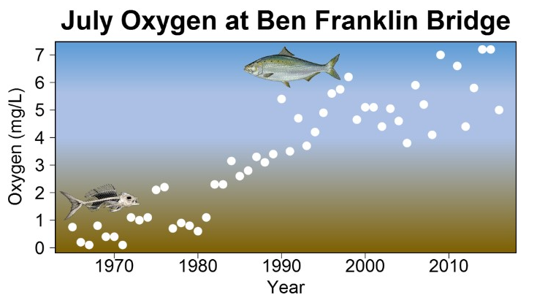
Cleanup of the Delaware River allowed the return of the American Shad
Notes:
https://www.nj.gov/drbc/edweb/shad-return.html

Slide 31
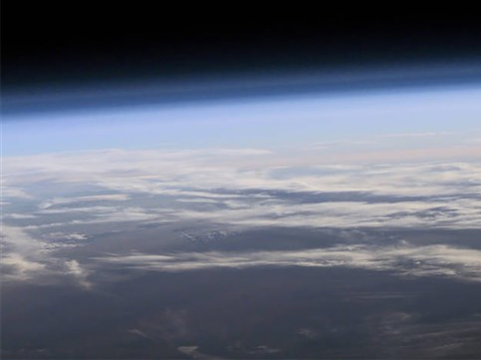
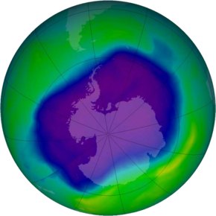
Good news: the ozone hole is shrinking!
Notes:
NASA image
https://ozonewatch.gsfc.nasa.gov/statistics/annual_data.html

Slide 32
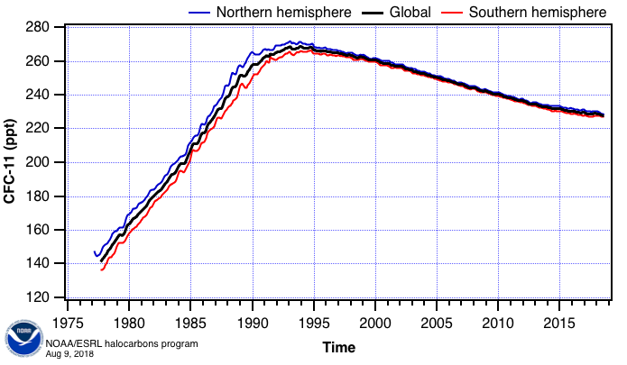
Why? Because levels of (human-produced) chlorofluorcarbons are dropping.
Montreal Protocol adopted
Notes:
https://www.esrl.noaa.gov/gmd/hats/combined/CFC11.html

Slide 33
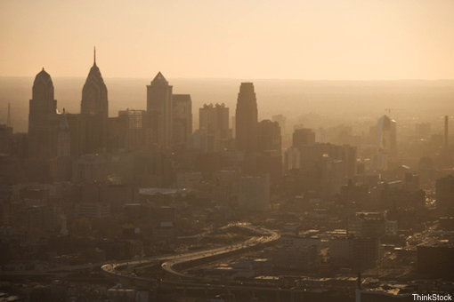
This is happening much less often than it used to
Ozone
NO₂
CO
SO₂
Lead
28%
52%
82%
83%
89%
Median change in US: 1980-2010
Data source: www3.epa.gov/airtrends

Slide 34
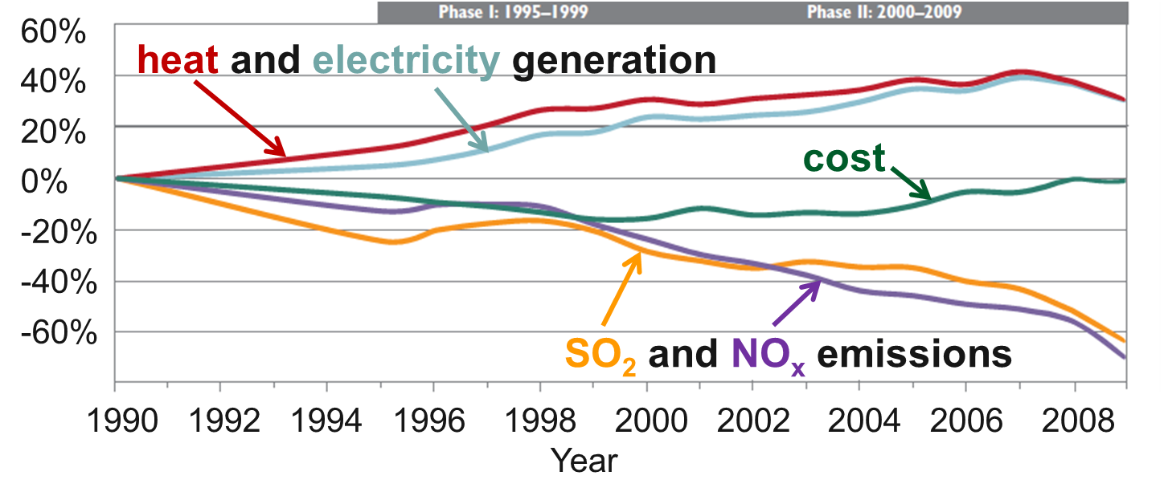
The Clean Air act reduced emissions and created $170 - $430 billion per year in health benefits—all while energy use went up and costs went down!
Burns et al. (2011)
Notes:
Burns, D.A., Baron, J.S., Cosby, B.J., Fenn, M.E., Lynch, J.A., 2011. National Acid Precipitation Assessment Program Report to Congress 2011: An Integrated Assessment. National Science and Technology Council, United States Government, Washington, D.C., 114 pp.

Slide 35
Opportunities

Slide 36
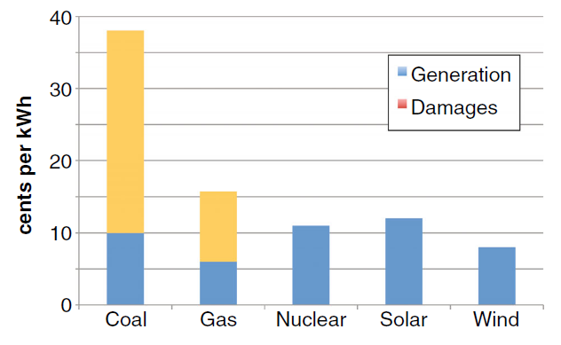
When damages to agriculture and health are considered, new electricity based on non-fossil sources is cheapest
Costs of new US electricity
Shindell (2015)
Notes:
Shindell, D.T., 2015. The social cost of atmospheric release. Climatic Change 130, 313–326.

Slide 37
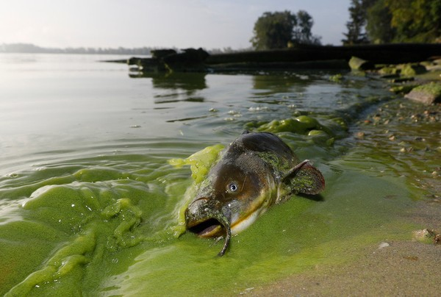
Less fossil fuel, less nitrogen pollution, fewer harmful algal blooms, fewer dead zones
Notes:
https://www.cleveland.com/metro/2017/10/lake_erie_algal_bloom_cleanup_1.html

Slide 38
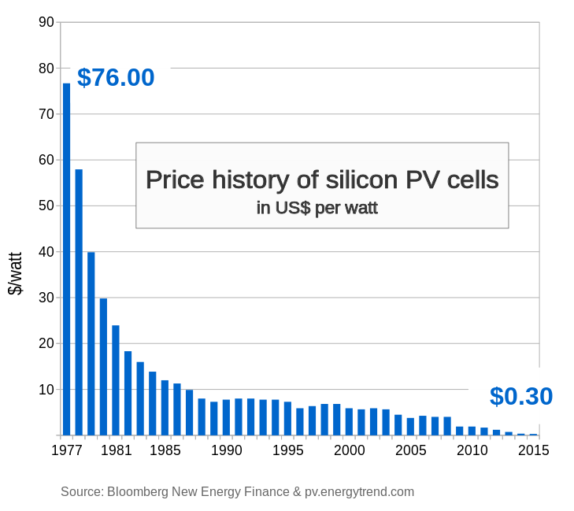
The cost to install solar has plummeted

Slide 39
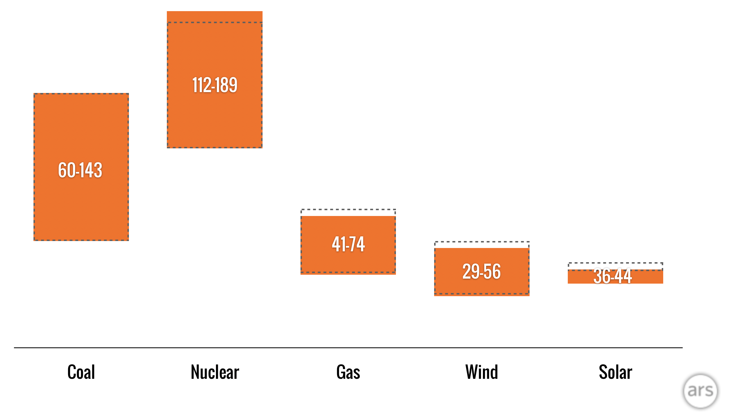
Renewables are cheap!
Costs of new installations in dollars per megawatt-hour
2018
2017
Coal Nuclear Gas Wind Solar
Notes:
https://arstechnica.com/information-technology/2018/11/new-year-same-story-cost-of-wind-and-solar-fall-below-cost-of-coal-and-gas/

Slide 40
Use of efficient light bulbs is skyrocketing …
Notes:
Department of Energy data
Graphic from NY Times: https://www.nytimes.com/interactive/2019/03/08/climate/light-bulb-efficiency.html

Slide 41
… and reducing electricity costs
Notes:
Department of Energy data
Graphic from NY Times: https://www.nytimes.com/interactive/2019/03/08/climate/light-bulb-efficiency.html

Slide 42
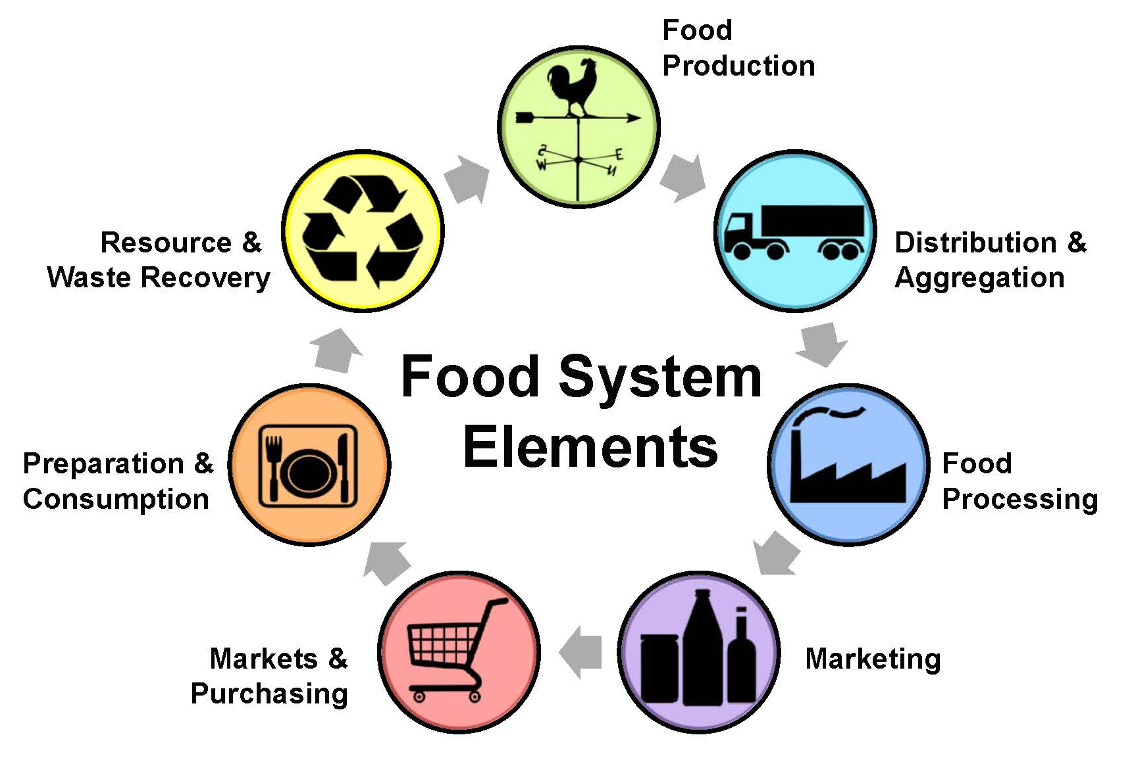
Food systems are responsible for one-quarter of greenhouse gas emissions
Notes:
http://lfs-teg-collab.sites.olt.ubc.ca/files/2015/12/Slide5.jpg

Slide 43
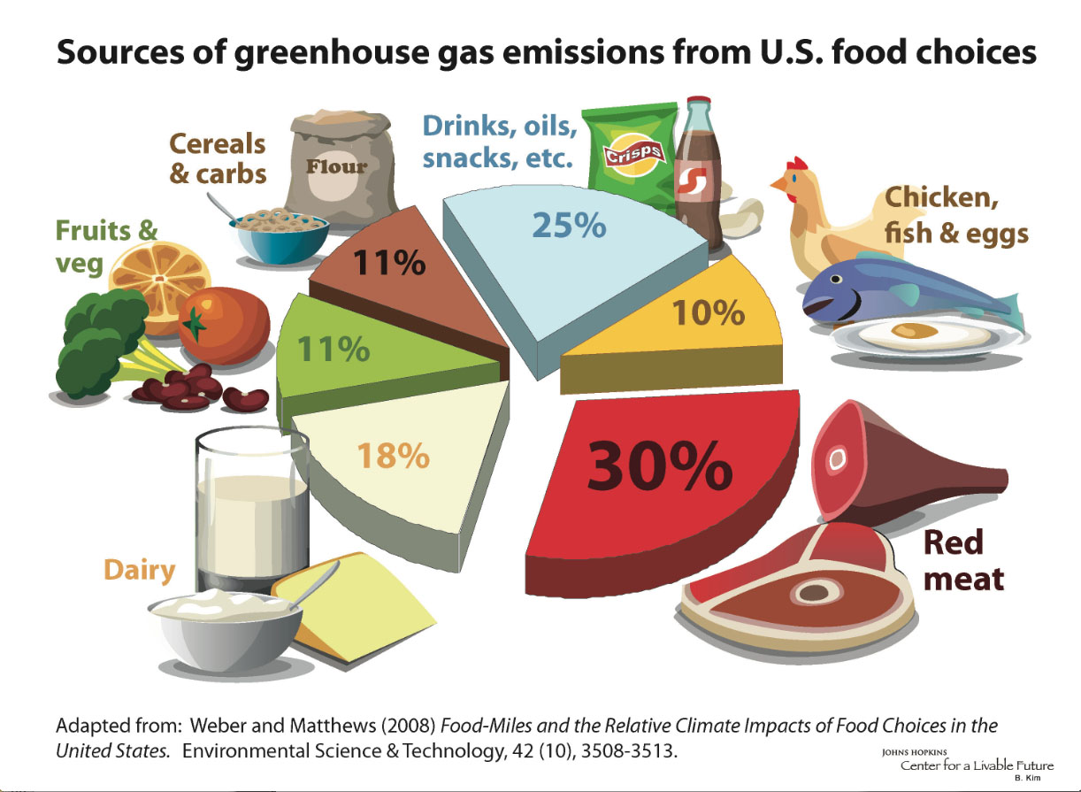
Notes:
http://www.foodsystemprimer.org/food-production/food-and-climate-change/index.html

Slide 44
Your diet matters!
Kilograms of CO₂ equivalent released in production and consumption of 50 grams of protein
Graphic: NY Times
Notes:
Poore, J., Nemecek, T., 2018. Reducing food’s environmental impacts through producers and consumers. Science 360, 987-992.
Graphic: https://www.nytimes.com/interactive/2019/04/30/dining/climate-change-food-eating-habits.html

Slide 45

Notes:
http://queenscarehealthcenters.org/wp-content/uploads/2015/03/Med_pyramid_flyer.jpg

Slide 46

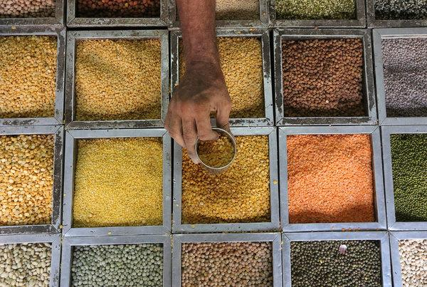


Cuisines that are easy on the planet
India
Vietnam
Venezuela
Lebanon
Notes:
https://www.nytimes.com/2019/04/30/climate/these-five-cuisines-are-easier-on-the-planet.html

Slide 47

Cuisines that are easy on the planet
America
Notes:
https://www.nytimes.com/2019/04/30/climate/these-five-cuisines-are-easier-on-the-planet.html

Slide 48

$4.32 per person per year in Medicare savings for every 1% increase in forest cover
Up to $9 billion in savings per year for the US
Notes:
Douglas A. Becker, Matthew H.E.M. Browning, Ming Kuo, Stephen K. Van Den Eeden. Is green land cover associated with less health care spending? Promising findings from county-level Medicare spending in the continental United States. Urban Forestry & Urban Greening, 2019; 41: 39 DOI: 10.1016/j.ufug.2019.02.012
Image: Getty Images;

Slide 49
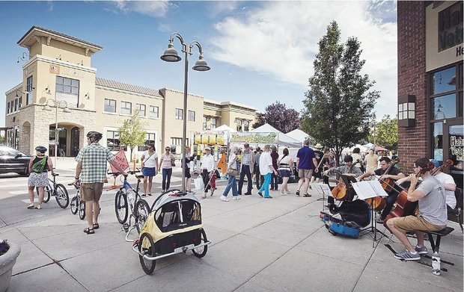
What if we kept our cars parked for trips less than one mile? In the US, each year we would save
$900 million in fuel and maintenance costs
2 million metric tons of CO₂ emissions
Walkable & bikable communities are healthier
and cleaner
Notes:
https://www.epa.gov/greenvehicles/what-if-we-kept-our-cars-parked-trips-less-one-mile

Slide 50
Action

Slide 51
Notes:
https://www.papowerswitch.com/

Slide 52
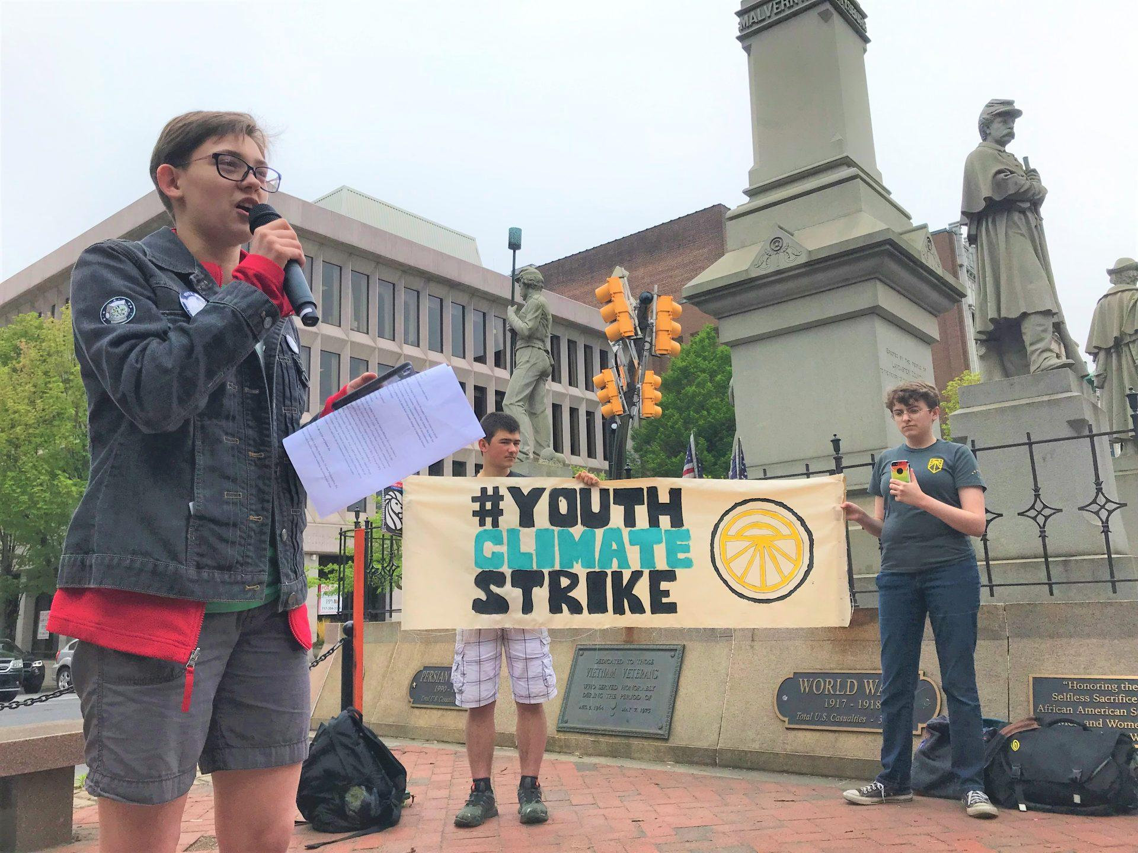
Notes:
https://www.wesa.fm/post/pa-youth-join-global-student-strike-demand-action-climate-change

Slide 53
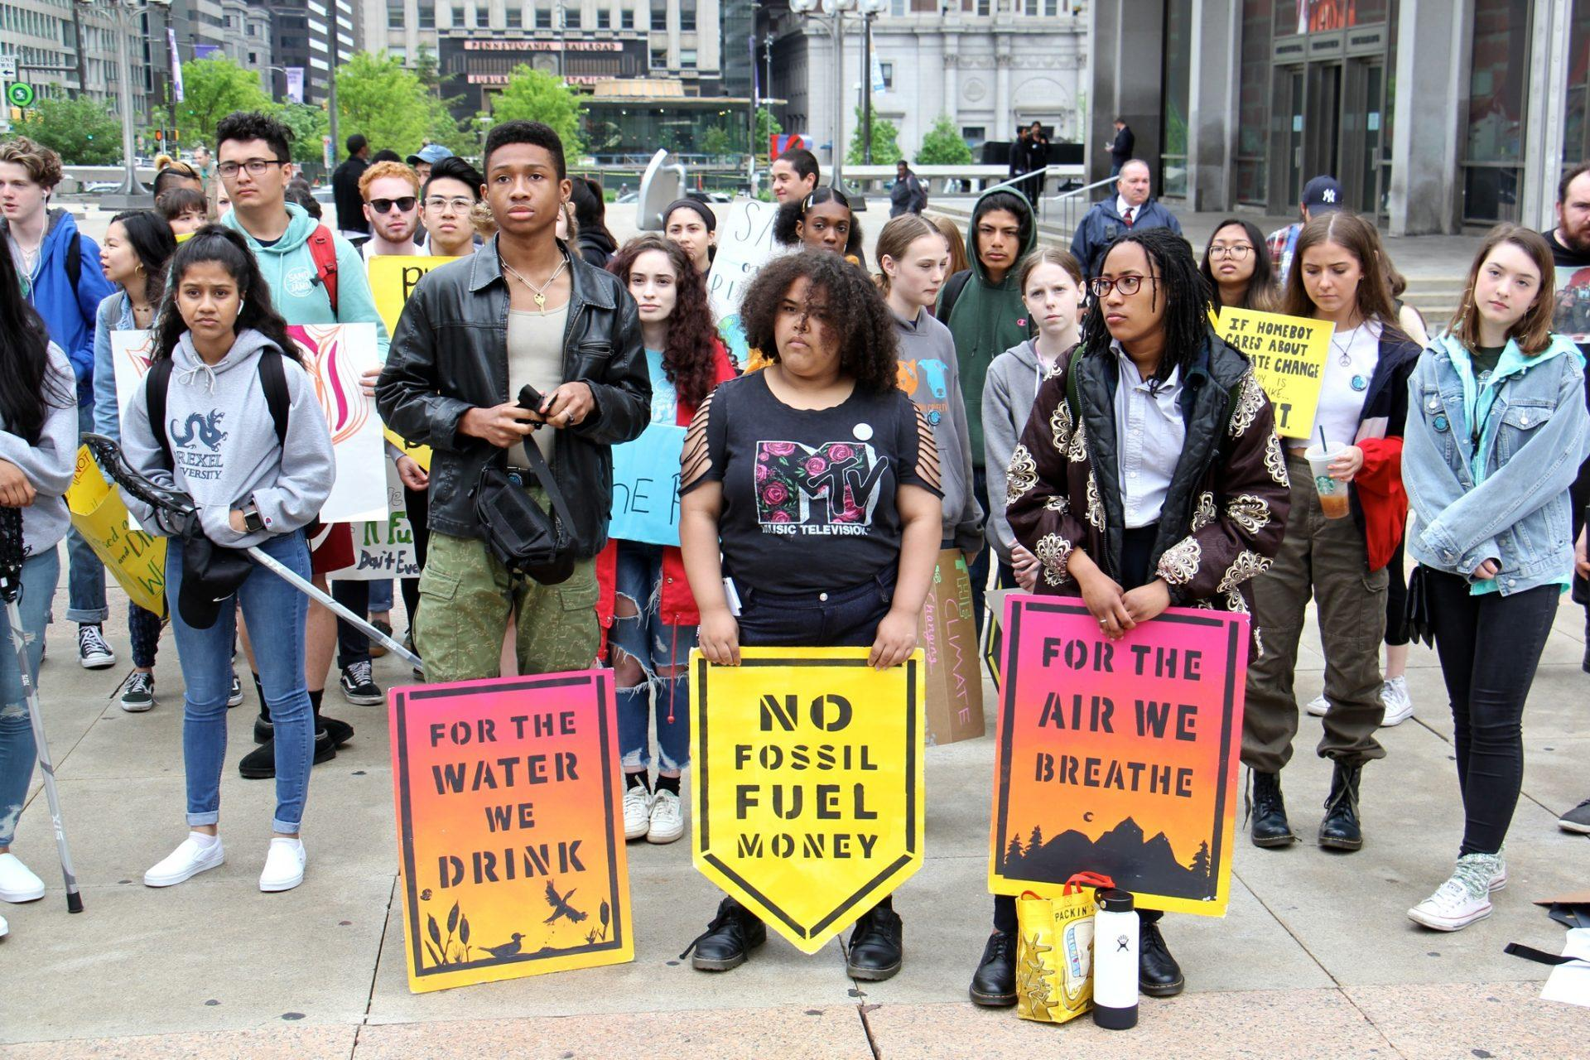
Notes:
https://www.wesa.fm/post/pa-youth-join-global-student-strike-demand-action-climate-change

Slide 54
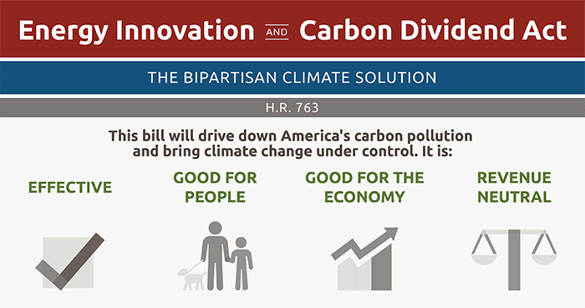

Notes:
https://citizensclimatelobby.org/energy-innovation-and-carbon-dividend-act/

Slide 55





Paris Climate Conference 2015
Agreement to keep global warming well below 2.0 ºC (3.6 ºF)
Source: COP21 Paris
Notes:
Image source: www.cop21paris.org/

Slide 56
Joel Pett, 2009

